Slide 1
OBESITY LEVEL PREDICTION USING DEEP LEARNING
Team Members:
Tejaswi Baggam (Student ID 111438294)
Model:
Feedforward Neural Network with Dropout
Dataset:
Obesity dataset (2,111 samples · 7 classes) + Fitbit Daily Activity
Stack:
Python 3.10 · PyTorch · SHAP · Streamlit
Repo:
https://github.com/tejupatnaik5-svg/obesity-prediction-dl/tree/main

Slide 2
Problem Statement
The Problem
7-Class Target
Obesity affects 1 B+ people worldwide; prevalence has tripled since 1975.
BMI is the standard clinical metric — but it ignores diet, activity, genetics, and behavior.
BMI cannot separate muscle from fat, so athletes get misclassified as overweight.
Prior ML approaches reach 80–88% accuracy but report no confidence or explanation.
Black-box predictions are clinically unusable — clinicians won't trust unaccounted outputs.
Insufficient · Normal · Overweight I · Overweight II · Obesity I · Obesity II · Obesity III
Captures the full continuum of obesity progression — not a binary obese/non-obese flag.
Why I Built This
A useful obesity tool has to do three things at once: predict accurately, signal how confident it is, and explain why. This project tackles all three — and ships them in a working Streamlit app, not a Jupyter notebook.
Goal: Classify users into 7 obesity stages with calibrated confidence + SHAP explanations + BMI/activity-aware recommendations.

Slide 3
Motivation — Why This Matters
Clinical Triage
Personalized Care
Resource Allocation
Identify high-risk individuals early for lifestyle intervention.
Seven stages enable graduated, tailored advice — not a binary verdict.
Public-health systems prioritize highest-risk populations first.
Wearable Integration
Insurance & Wellness
Trustworthy AI
Plug in Fitbit / Garmin data for passive, continuous risk monitoring.
Triage-grade scoring for underwriting and corporate-health programs.
SHAP + confidence make the model auditable — required for clinical use.

Slide 4
Related Works
Method | Authors / Year | Key Idea | Relevance
Logistic Regression | Classical baseline | Linear decision boundaries on lifestyle features | Reference for non-linear gains
Random Forest | Palechor & de la Hoz, 2019 | Tree ensemble on the same obesity dataset | Prior 80–88% accuracy benchmark
Deep MLP | LeCun et al., Nature 2015 | Feedforward nets learn non-linear feature interactions | Core architecture we adopt
Dropout | Srivastava et al., JMLR 2014 | Random activation masking prevents co-adaptation | Regularization on a modest dataset
SHAP | Lundberg & Lee, NeurIPS 2017 | Game-theoretic feature attribution | Explainability layer of this system
Calibration | Guo et al., ICML 2017 | Modern nets are systematically overconfident | Motivates softmax-threshold flagging

Slide 5
Method: Pipeline Overview
1
2
3
4
5
Data Loading
Preprocessing
MLP Training
Evaluation
Streamlit App
2,111 samples · 17 features
(8 numeric · 9 categorical)
One-hot encode categoricals
+ StandardScaler
+ 80/20 split (seed 42)
4-layer MLP · ReLU · Dropout 0.3
Adam (lr 0.001) · 40 epochs
CrossEntropyLoss
Test accuracy
+ softmax confidence
+ SHAP attribution
BMI + Fitbit auto-detect
+ prediction + SHAP top-5
+ health tips
Network Architecture
Input (d_in features after one-hot) → Hidden 1 (128 · ReLU · Dropout 0.3) → Hidden 2 (64 · ReLU · Dropout 0.3) → Hidden 3 (32 · ReLU) → Output (7 logits)

Slide 6
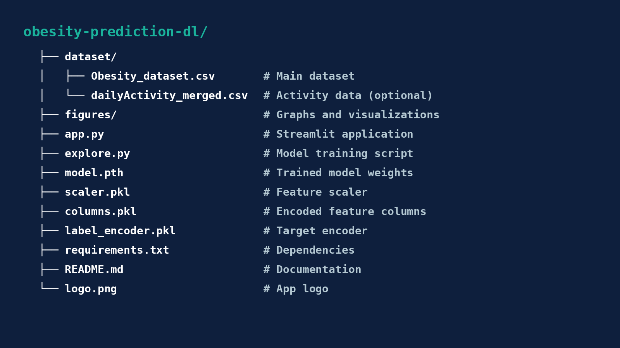
Code Structure & Reproduction
Quick Start (Python 3.10+)
├── explore.py ← EDA: feature types, class balance
$ git clone <repo-url>
├── model.py ← MLP definition + training loop
$ python -m venv venv && source venv/bin/activate
├── evaluate.py ← Accuracy + confidence + SHAP
$ pip install -r requirements.txt
├── app.py ← Streamlit UI + Fitbit detector
$ python model.py # train + save artifacts
├── artifacts/
│ ├── model.pth ← Trained PyTorch weights
$ streamlit run app.py # → localhost:8501
│ ├── scaler.pkl ← Fitted StandardScaler
│ ├── columns.pkl ← One-hot column order
Key Dependencies
│ └── label_encoder.pkl
Python 3.10+ · PyTorch 2.0
Pandas · Scikit-learn · NumPy
SHAP (KernelExplainer)
Streamlit · Matplotlib · Joblib
│ ├── obesity.csv ← 2,111 samples · 17 features
│ └── fitbit.csv ← Daily activity records
└── requirements.txt

Slide 7
Results & Demo Walkthrough
Accuracy
Training
89% on held-out test set (7-class)
Beats prior 80–88% RF baseline on the same dataset.
Loss converges 1.05 → 0.33 over 40 epochs.
No oscillation — dropout did its job.
Confidence
SHAP
≥0.97 for extreme classes (Normal, Obesity III).
0.72–0.75 for borderline overweight — flagged for review.
Top features: Weight, Height, Physical Activity.
Clinically plausible — not spurious correlations.
Demo Flow: user inputs → BMI auto-calc with WHO color codes → Fitbit auto-detects activity level → MLP inference → SHAP top-5 features → personalized health tips.

Slide 8
Limitations — What Didn't Work
Wearable Integration is Simulated
Softmax ≠ Calibrated Probability
App samples a random Fitbit row instead of pulling live data from a user's device. The pipeline works — the data source is offline.
Modern nets are systematically overconfident (Guo et al., 2017). A reported 0.90 is 'relatively certain', not 'right 90% of the time'.
Dataset Demographic Bias
SHAP Latency
Training data comes from Colombia, Peru, Mexico only. Will not generalize cleanly to populations with very different dietary norms.
KernelExplainer runs ~2–5 seconds per prediction inside the app. Acceptable for demo, not for high-volume production use.
No Per-Class Metrics
Edge Cases Underperform
Overall 89% reported; precision / recall / F1 per class are not yet broken out — the borderline overweight classes likely lag.
Elite athletes, metabolic disorders, and weight-affecting medications fall outside the training distribution.

Slide 9
Elevator Pitch
"Every year, billions of healthcare dollars go to treating downstream complications of obesity — diabetes, cardiovascular disease, joint replacement — when earlier behavioral intervention would have been cheaper and kinder. The blocker isn't data, it's triage: clinicians and wellness platforms don't have a fast, trustworthy way to grade individual risk.
Our system is a deep-learning obesity-risk engine that classifies any individual into one of seven stages with 89% accuracy, tells you exactly how confident it is, and uses SHAP to explain every prediction in plain features — weight, activity, eating patterns. It already plugs into Fitbit-style activity data and ships as a working Streamlit app.
We're targeting corporate wellness programs, life and health insurers, telehealth platforms, and wearable vendors — anyone who needs triage-grade risk scoring without the black-box liability.
Think of us as a smoke detector for obesity risk — early, explainable, always-on."

